Slide 1


Optimization Algorithms
Lecture 1: Course Presentation
Alaa Khamis, Ph.D
AI and Smart Mobility Professor at KFUPM and Ex- GM Technical Leader
This lecture is based on Part-I Deterministic Search Algorithms of the textbook: Optimization Algorithms: AI techniques for design, planning, and control problems, Manning Publication, 2024.
2025 © Dr. Alaa Khamis

Slide 2
Outline
Course Description
Course Topics
Course Outline
Grading
Assignments
Course Project
Resources
Notes:
2

Slide 3
Outline
Course Description
Course Topics
Course Outline
Grading
Assignments
Course Project
Resources
Notes:
3

Slide 4
Course Description
This course focuses on how heuristic search algorithms tackle complex, ill-structured problems across various domains. Adaptive aspects of these algorithms will be discussed, and in-depth case studies are explored.
Exploration-exploitation dilemma
An ill-structured problem
Design problem
Planning problem
Control problem
Heuristic Search Algorithm
Optimal or near-optimal solution
Adaptation
Deterministic approach
Adaptive approach
Self-adaptive approach
Notes:
4

Slide 5
Course Description
Well-structured Problems (WSP)
A priori knowledge
Initial states
Problem Space
Problem Solver
Updated state
Monitoring
Goal state
Solution execution upon external world
Feasible states
Proposed solution
Evaluation Criterion
Optimal/near-optimal solution
Operators
Legal moves/ transitions
Stopping criteria
Hard/Soft Constraints
Generate alternative solution
Computational tractability
Notes:
5

Slide 6


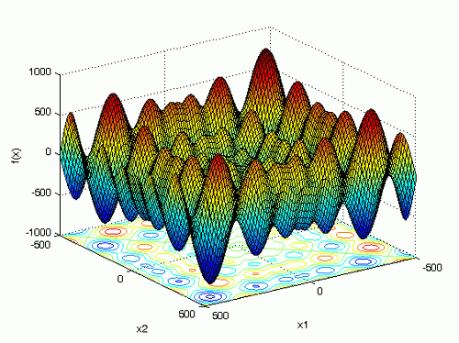
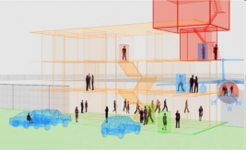
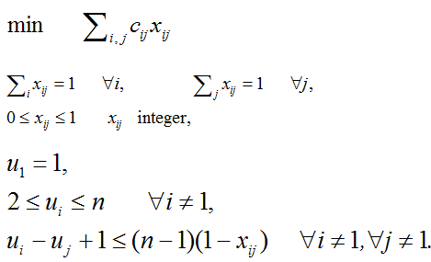
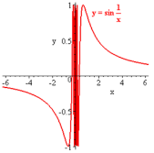





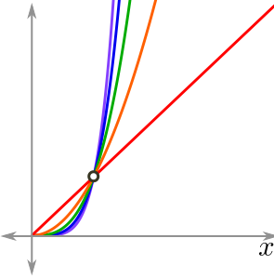
Course Description
Ill-structured Problems (ISP)
Problem Space
Problem Solver
Different views of problem
Unclear Goal
Multimodality
Dynamic nature
Lack of exact mathematical model
Non-Differentiability
No algorithmic solutions
Evaluation Criterion
Monitoring
Considerable uncertainty, partial observability, vagueness, incomplete information, ambiguity and unpredictability
Solutions are contradictory
Consequence difficult to predict
Risk difficult or impossible to calculate
Computation
Computational intractability
Notes:
6

Slide 7
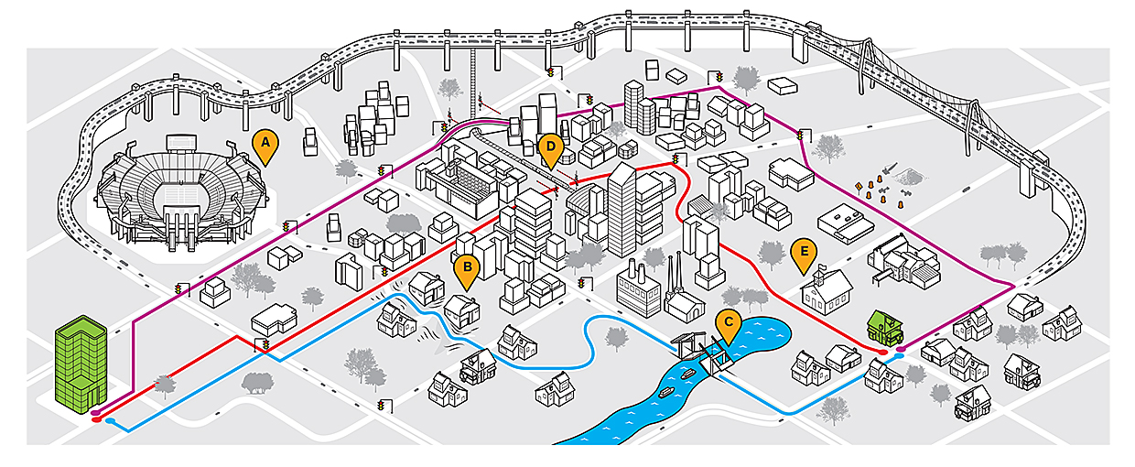
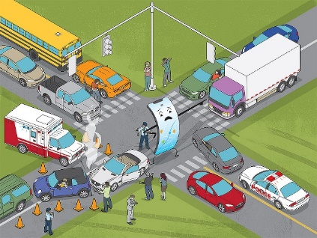
Course Description
ISP: Routing and Navigation
[Source]
Dynamic nature . Different views of problem . Partial observability . Incomplete information . Multimodality
Notes:
7

Slide 8
Course Description
ISP: Elevator dispatching
Dynamic nature . Partial observability . Computation
10⁴
.
2⁴⁰
.
18⁴
≈
10²¹
Elevator positions
Each elevator can be on one of 10 floors. Therefore, for each elevator, there are 10 different possible states. Since there are four elevators, the number of combinations for elevator positions is 10⁴.
Elevator buttons
Each elevator has 10 buttons that can be either on (pressed)
or off (not pressed). Therefore, for one elevator, there are 210 different possible
states. Since there are four elevators, the number of combinations for elevator
buttons is 2⁴⁰.
Hall call buttons
There are 18 hall call buttons (up and down buttons at each
floor, except the first and the last floor) that can be either on or off. Therefore,
the number of combinations for hall call buttons is 2¹⁸.
States
Notes:
8

Slide 9
Course Description
WSP but practically ISP: TSP
Given n cities,
A travelling salesman must visit the n cities and return home, making a loop (roundtrip).
He would like to travel in the most efficient way (cheapest way or shortest distance or some other criterion).
Search Space
Search space is BIG:
for 14 cities there are (14-1)! ≈ 622,702,080 possible tours *. This is NP-hard problem.
*Fortunately, dynamic programming algorithms enable reduced complexity as explained in Chapter 2 of the textbook.
Notes:
9

Slide 10
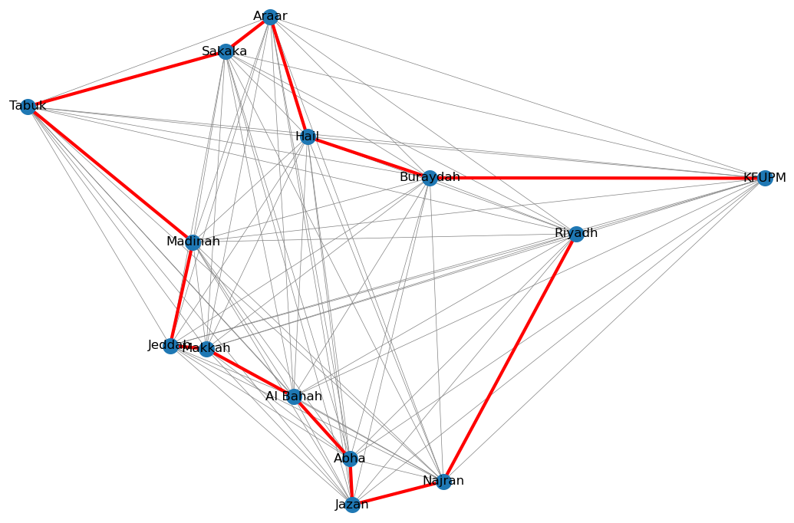
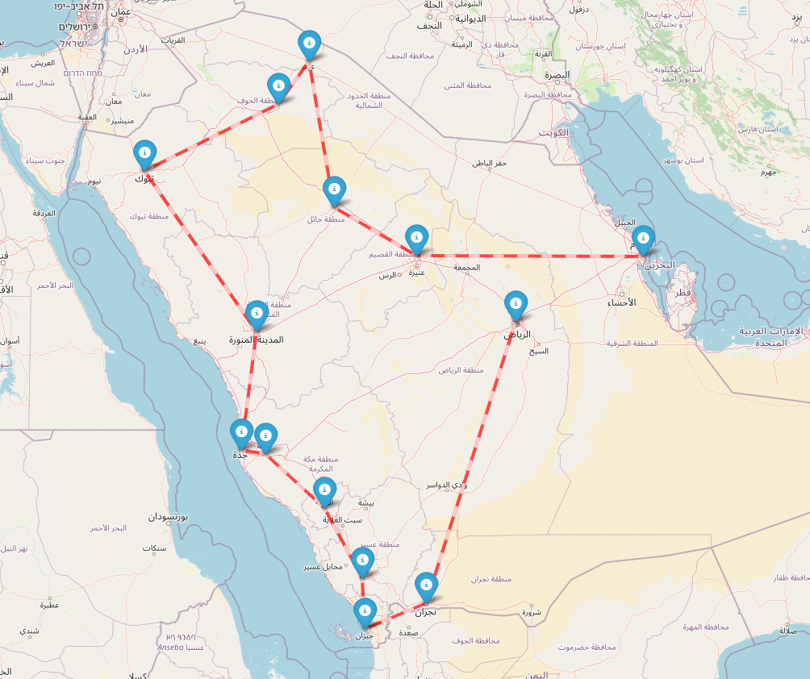
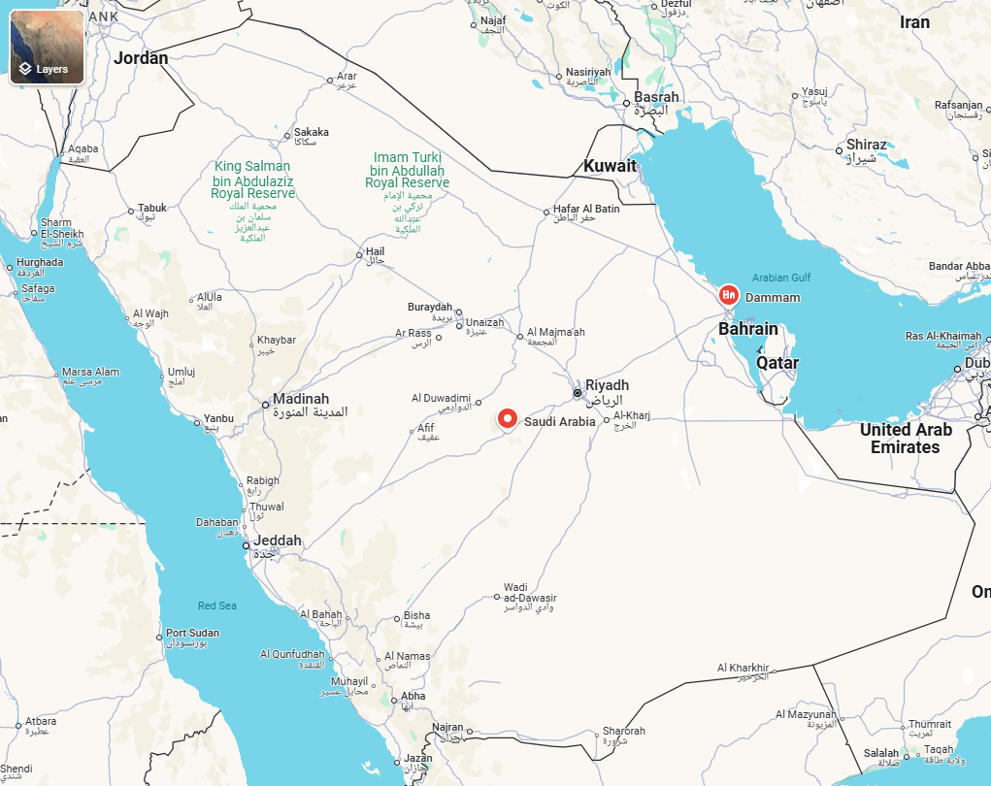

Course Description
4751 mile route:
KFUPM ➞ Buraydah ➞ Hail ➞ Araar ➞ Sakaka ➞ Tabuk ➞ Madinah ➞ Jeddah ➞ Makkah ➞ Al Bahah ➞ Abha ➞ Jazan ➞ Najran ➞ Riyadh
WSP but practically ISP: TSP
Raw data
cities = {
'KFUPM': (26.3126, 50.1403),
'Riyadh': (24.7136, 46.6753),
'Buraydah': (26.3250, 43.9748),
'Hail': (27.5114, 41.7208),
'Araar': (30.9753, 41.0381),
'Sakaka': (29.9697, 40.2064),
'Tabuk': (28.3838, 36.5662),
'Madinah': (24.4709, 39.6122),
'Jeddah': (21.4858, 39.1925),
'Makkah': (21.3891, 39.8579),
'Al Bahah': (20.0129, 41.4677),
'Abha': (18.2164, 42.5053),
'Jazan': (16.8891, 42.5510),
'Najran': (17.5650, 44.2236)
}
Heuristic Method
Notes:
10

Slide 11
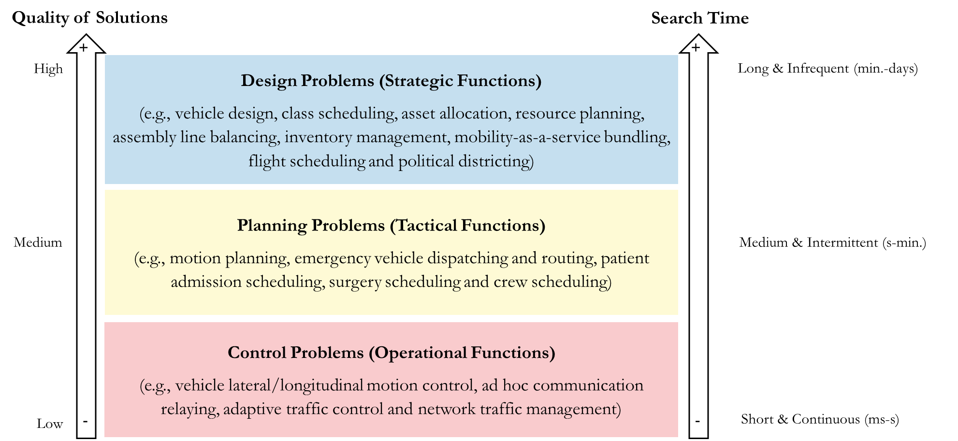
Course Description
Optimization Problems
Notes:
11

Slide 12
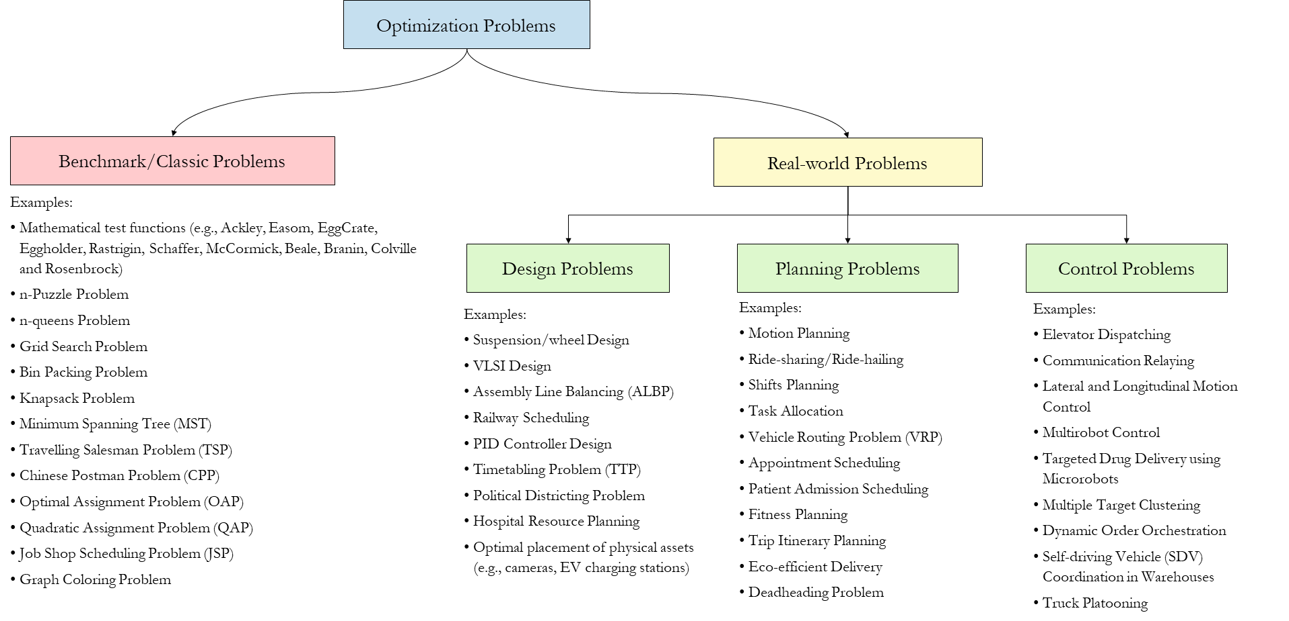
Course Description
Optimization Problems
Notes:
12

Slide 13
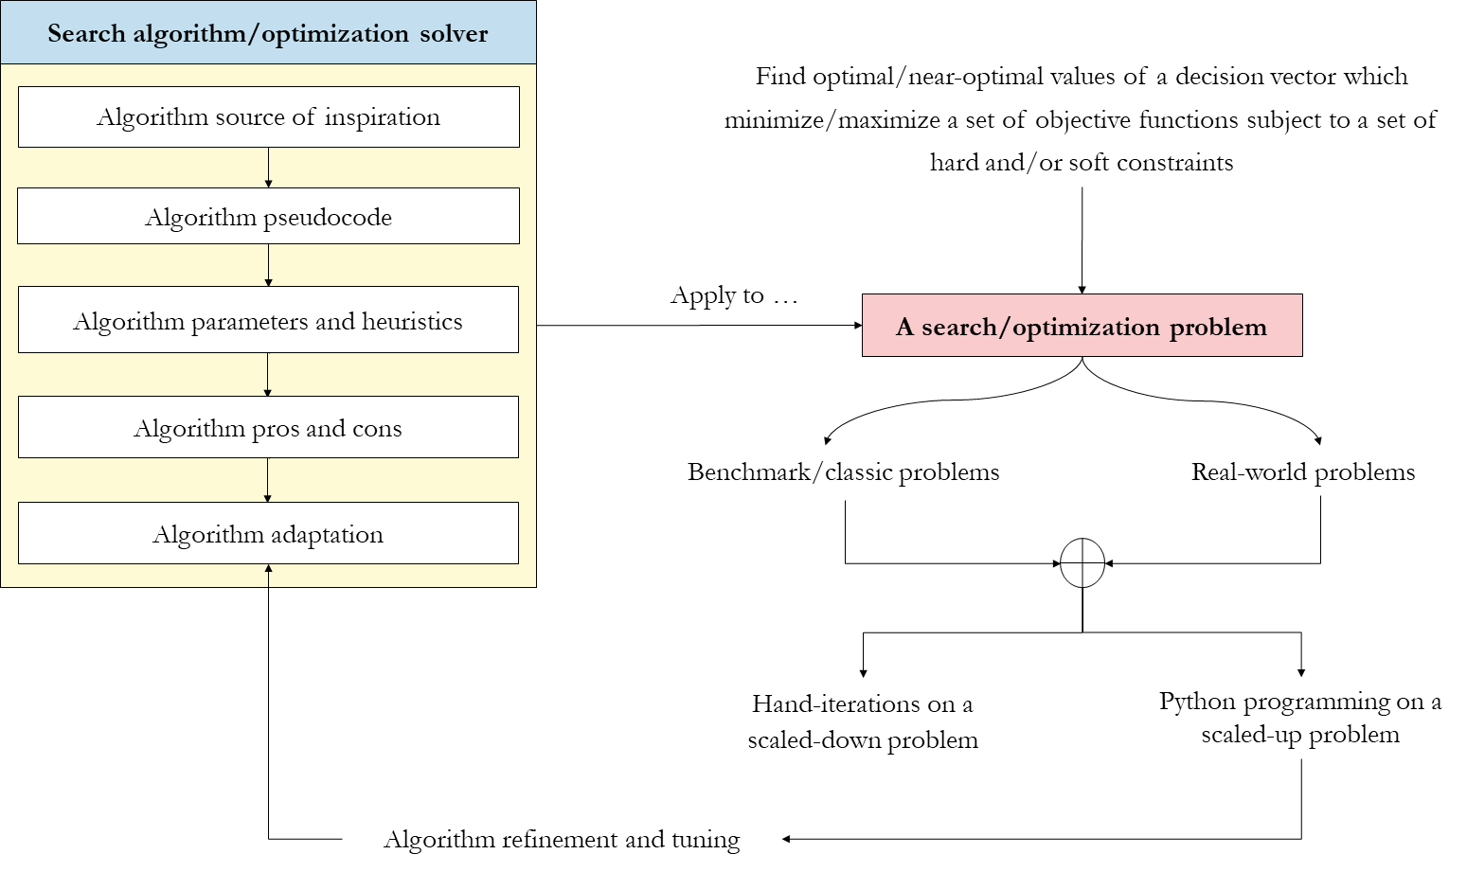
Course Description
Teaching Methodology
Notes:
13

Slide 14
Outline
Course Description
Course Topics
Course Outline
Grading
Assignments
Course Project
Resources
Notes:
14

Slide 15
Course Topics
Search and optimization
Heuristics and metaheuristics
Graph search methods
Stochastic search
Genetic algorithms
Swarm intelligence algorithms
Machine learning methods
Notes:
15

Slide 16
Outline
Course Description
Course Topics
Course Outline
Grading
Assignments
Course Project
Resources
Notes:
16

Slide 17
Course Outline
Week | Lecture-1 | Lecture-2
1 | Course presentation | Introduction to heuristic search
2 | Graph search methods-I | Graph search methods-II
3 | SA-I | SA-II
3 | Team formation and problem selection deadline
4 | SA use cases-I | SA use cases-II
5 | TS-I | TS-II
6 | TS use cases-I | TS use cases-II
7 | GA-I | GA-II
8 | GA use cases-I | GA use cases-II
9 | PSO-I | PSO-II
10 | PSO use cases-I | PSO use cases-II
11 | Midterm Exam
12 | ACO-I | ACO-II
13 | ACO use cases-I | ACO use cases-II
14 | ML Methods-I | ML Methods-II
15 | ML use cases-I | ML use cases-II
16 | Revision | Revision
17 | Final Exam
Notes:
17

Slide 18
Outline
Course Description
Course Topics
Course Outline
Grading
Assignments
Course Project
Resources
Notes:
18

Slide 19
Grading
Evaluation Method | Weight
Assignments | 20%
Problem Definition and Characterization | 10%
Literature Review | 10%
Mid-term Exam | 30%
Final Exam/Course Project (in case of course-based project) | 50%
General quality of the IEEE article | 10%
Originality/level of innovativeness and significance of theory and/or practice | 10%
Experimental results and quantitative and qualitative analysis | 10%
Implementation of adaptive version of the algorithms | 10%
Quality of the Jupyter Notebook | 10%
Total | 100%
Notes:
19

Slide 20
Outline
Course Description
Course Topics
Course Outline
Grading
Assignments
Course Project
Resources
Notes:
20

Slide 21
Assignments
Assignment-1 Problem Definition and Characterization
Students will pick an ill-structured problem that interests them. A list of suggested problems is provided. The students write the statement of work (SOW) that contains the following sections: Problem Characterization: Define the problem, summarize its importance, highlight the challenging aspects, and include relevant statistics to illustrate the scope and impact of the problem. Problem Formulation and Modeling: provide a mathematical formulation of the problem and discuss possible modeling approaches.
Assignment-2 Literature Review
The students will conduct a critical survey of state-of-the-art approaches to solving the selected problem, highlighting the pros and cons of these approaches. Students may also suggest a taxonomic classification of these approaches showing how they are related or how they can be classified based on different well-defined criteria. The survey should cover recent related works (from the last 2-3 years) reported in the literature.
Notes:
21

Slide 22
Outline
Course Description
Course Topics
Course Outline
Grading
Assignments
Course Project
Resources
Notes:
22

Slide 23
Course Project
Students explore the applicability of the different algorithms studied in the course to solve the selected problem.
Students choose a heuristic search algorithm to handle this problem and justify their choice.
Students establish a set of evaluation metrics and analyze experimentally the performance of the algorithm implemented in Python with different parameters. Students must identify the pros and cons of the implemented solution and how this solution differs or extends the related approaches reported in the recent literature .
Students conduct a comparative study between the selected approach and other potential approach to quantitatively and qualitatively evaluate these approaches in terms of a number of well-defined evaluation metrics and using the problem data as a benchmark dataset.
Notes:
23

Slide 24
Course Project
Suggested Project Ideas: Design Problems
Optimal placement of physical assets (EV charging station, city bike terminal, walking routes, cycling lanes, air taxi takeoff and landing, traffic sensors, distribution points, wildlife corridors, wind park design)
Districting problems (Political districting, school bus routing, postal or package delivery, waste collection, sales territory design, public transport service areas, emergency service districting and maintenance districting)
Scheduling problems (course timetabling class, train scheduling, crew or flight scheduling)
Vehicle design (engine, suspension, tire, etc.)
MaaS bundling
Manufacturer’s Suggested Retail Price (MSRP) and incentive optimization
Notes:
24

Slide 25
Course Project
Suggested Project Ideas: Planning Problems
Optimal deployment of physical assets (ambulances or fire trucks, mobile healthcare units, mobile speed cameras/radar, patrolling units, mobile sensors, machinery for projects, etc.)
Dynamic pricing of public transit (roadway congestion pricing, public transit peak pricing, ride-sharing platforms, airline tickets, ferry services, parking rates, railway and bus pricing, electric vehicle charging stations, freight transportation, shipping fees, etc.)
Multicriteria-routing problem
Optimal dispatching for ridehailing or ridesourcing or last-mile delivery services
Deadheading problem
Trip itinerary planning and Fitness planning.
Notes:
25

Slide 26
Course Project
Suggested Project Ideas: Control Problems
Vehicle lateral/longitudinal motion control
Ad hoc communication relaying
Adaptive traffic control
Network traffic management
Notes:
26

Slide 27
Course Project
Project Report:
Final project report should be prepared as a 5-6 pages IEEE paper. Students must comply strictly with the formatting instructions using IEEE Manuscript Templates.
Samples of previously published papers:
Cooperative Variable Speed Limit Control using Multi-agent Reinforcement Learning and Evolution Strategy for Improved Throughput in Mixed Traffic
Deep Reinforcement Learning-based Traffic Signal Control
Optimal Placement of Bus Stops using Particle Swarm Optimization
Optimal Placement of Drone Delivery Stations and Demand Allocation using Bio-inspired Algorithms
School Bus Routing using Metaheuristics Algorithms
A Metaheuristic Approach to Emergency Vehicle Dispatch and Routing
Trip Itinerary Planning: A Bio-inspired Metaheuristic Approach
Multi-criteria Optimal Routing for Last-mile Parcel Delivery
Notes:
27

Slide 28
Outline
Course Description
Course Topics
Course Outline
Grading
Assignments
Course Project
Resources
Notes:
28

Slide 29

Resources
Textbooks
Alaa Khamis. Optimization Algorithms: AI Techniques for Design, Planning, and Control Problems. Manning Publication, ISBN 9781633438835, 2024.
Notes:
29

Slide 30

Resources
Open-source sample codes and data
Textbook GitHub repo: https://github.com/Optimization-Algorithms-Book/Code-Listings
AI for Smart Mobility Medium Publication Hub
Join us
Notes:
30

Slide 31

GenAI Dos and Don’ts
Q: Why do we have to learn when ChatGPT and other AI tools can do everything?
Notes:
31

Slide 32

GenAI Dos and Don’ts
We’re teaching you the language of Engineering so you can use the tools wisely & responsibly.
AI is only as powerful as the person using it!
Generate by Gemini
Notes:
32

Slide 33


GenAI Dos and Don’ts
Do use GenAI tools responsibly and ethically to enhance learning and research
Do use GenAI for brainstorming and proofreading
Do cite any AI assistance
Don’t blindly trust GenAI without fact-checking
Don’t use GenAI as the only source of information
Don’t use GenAI to complete entire assignments
Don’t overuse GenAI to avoid cognitive offloading
Notes:
33

Slide 34
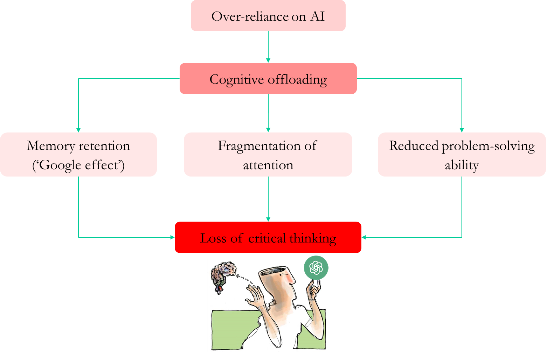
GenAI Dos and Don’ts
Notes:
34

Slide 35
Questions?
Notes:
35

